Slide 1
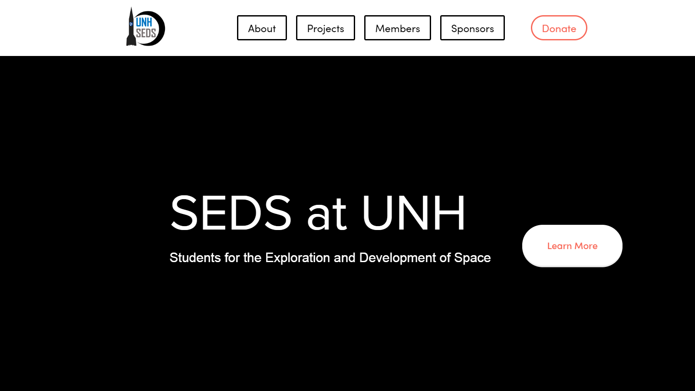
https://www.unhseds.org/

Slide 2
Who we are
UNH SEDS, or the University of New Hampshire Students for the Exploration and Development of Space, is an interdisciplinary engineering team motivated by our shared passion to further human knowledge in space exploration by combining our studies with meaningful projects.
Our team consists of over 30 members from all grades and fields of study. We participate in outreach to the greater seacoast area, research and competitions through the CEPS USRC and much more.
Follow the link below for more information, https://www.unhseds.org/mission-index-impact

Slide 3
Our history
UNH SEDS has been around for 5 semesters, during that time we have completed 3 classes of rockets and are currently working with our Seniors on our fourth.
Experimental Class
Consisting of 2 Rockets.
Ather Class.
Consisting of 7 Rockets.
USRC Carbon Fiber Class.
Consisting of 1 Rocket.
Hybrid Engine Rocket.
Current production.
Follow the link below for more information,
https://www.unhseds.org/projects/

Slide 4
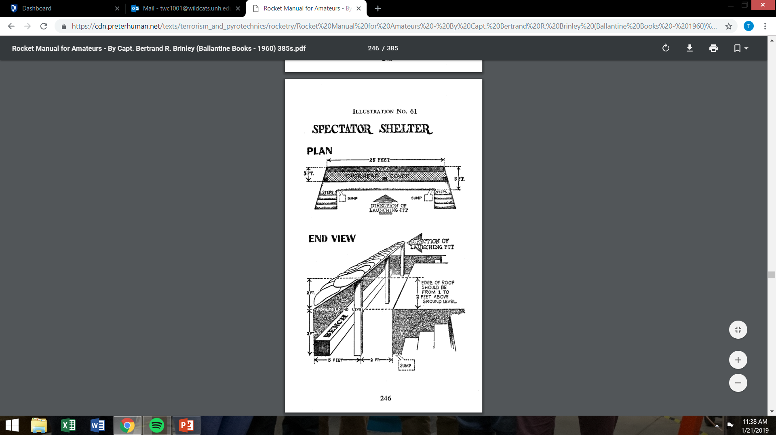
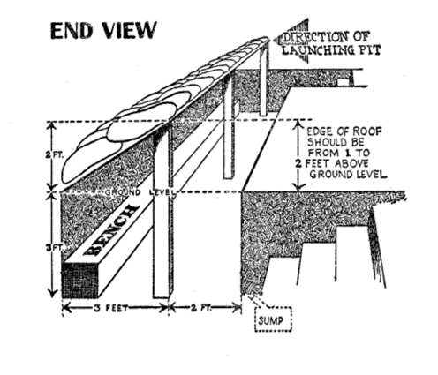

Slide 5

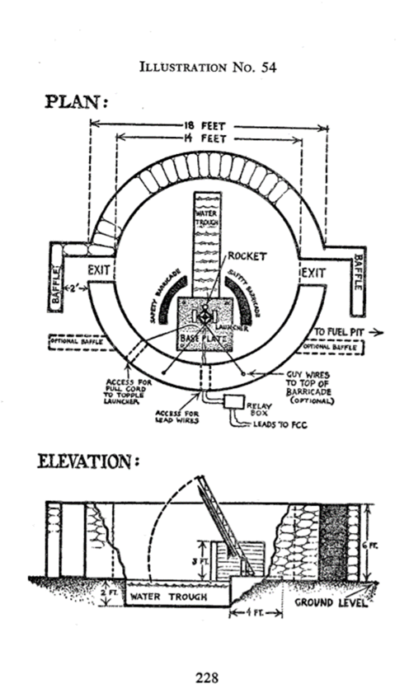

Slide 6
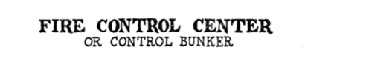
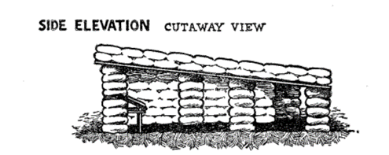


Slide 7
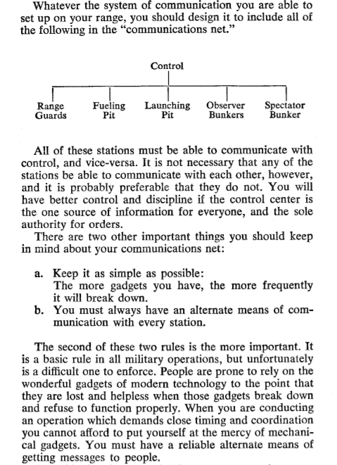

Slide 8
Lee Hook Field

Slide 9
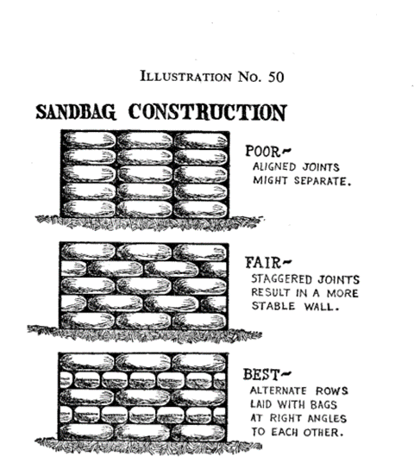


Slide 10
